Slide 1
XYZ Ads Airing Report Analysis
Description
dataset having different TV Airing Brands, their product, their category. Dataset includes the network through which Ads are airing, types of network like Cable/ Broadcast and the show name also on which Ads got aired Time zone and the time & date at which Ads got aired. IT also includes other data like Pod Position (the lesser the valuable), duration for which Ads aired on screen, Equivalent sales &, total amount spent on the Ads aired.
Business Understanding
Advertising is a way of marketing your business in order to increase sales or make your audience aware of your products or services. Until a customer deals with you directly and actually buys your products or services, your advertising may help to form their first impressions of your business. Target audience for businesses could be local, regional, national or international or a mixture. So they use different ways for advertisement

Slide 2
Approach
The given data is cleaned and there is no need of doing the cleaning of the data and I used the excel ,power point to do this project and also used pivot table and some of the formulas of excel
Tech-Stack Used
excel powerpoint and notepad

Slide 3
INSIGHT
I got the information about advertising techniques and and how much the amount spends for advertising for their brand promotion
And also I got information of which day of the week and month the ad is more broadcasting
I got the information of day part
What are the aspect they considering while broad casting the ad
Which company is spending more money on add and also less spending company

Slide 4
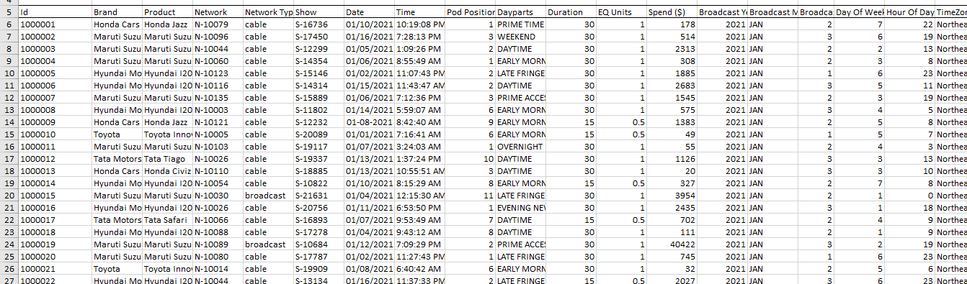
Working file (data)

Slide 5
There are 19 column and
731789 rows are their
And it is cleaned no requi
re of cleaning data
Id
Brand
Product
Network
Network Type
Show
Date
Time
Pod Position
Dayparts
Duration
EQ Units
Spend ($)
Broadcast Year
Broadcast Month
Broadcast Week
Day Of Week
Hour Of Day
TimeZone

Slide 6
POD POSITION
MEANING
The position of an individual advertisement within a certain commercial pod OR basically the Sequence in which the ads are played on TV, Like which ad plays in the beginning followed by which one and so on
Explain in Details with examples from the dataset provided
BRAND NAME | 1 | 2 | 3 | 4 | 5 | 6 | 7 | 8 | 9 | 10 | 11 | 12 | 13 | 14 | 15 | 16 | 17 | 18 | 19 | 20 | 21 | 22 | 23 | 24 | 25 | 26 | 27 | 28 | 29 | 30 | 31
Honda Cars | 512 | 535 | 564 | 603 | 556 | 599 | 618 | 595 | 635 | 669 | 643 | 614 | 617 | 514 | 516 | 418 | 331 | 279 | 280 | 258 | 253 | 328 | 329 | 297 | 194 | 146 | 312 | 91 | 161 | 37 | 165
Hyundai Motors India | 2,888 | 1,811 | 2,467 | 3,359 | 2,518 | 2,621 | 2,324 | 2,611 | 2,477 | 2,110 | 2,139 | 2,446 | 2,551 | 2,170 | 2,015 | 1,891 | 1,971 | 1,469 | 2,258 | 3,429 | 3,467 | 3,917 | 1,793 | 1,291 | 276 |  |  |  | 1,679
Mahindra and Mahindra | 3,723 | 2,394 | 2,543 | 2,734 | 2,632 | 2,490 | 2,228 | 2,229 | 2,140 | 2,094 | 2,192 | 2,277 | 2,329 | 2,929 | 2,720 | 1,965 | 2,528 | 3,204 | 2,694 | 3,223 | 1,972 | 1,687 | 935 | 1,497 | 897 | 16,175 |  | 294 | 101 |  | 274
Maruti Suzuki | 1,730 | 1,776 | 2,163 | 2,334 | 2,252 | 2,226 | 2,082 | 1,924 | 1,892 | 1,988 | 2,083 | 2,311 | 2,213 | 2,400 | 2,372 | 2,603 | 2,453 | 2,449 | 2,973 | 1,890 | 1,575 | 2,105 | 1,932 | 2,136 | 2,639 | 819 | 394 | 274 | 90 |  | 2,569
Tata Motors | 1,209 | 1,124 | 1,202 | 1,210 | 1,190 | 1,202 | 1,183 | 1,049 | 1,091 | 1,005 | 1,090 | 1,234 | 1,149 | 1,100 | 991 | 1,057 | 653 | 681 | 754 | 1,283 | 854 | 259 | 650 | 141 | 1,344 | 182 | 2,830 | 7 |  | 11
Toyota | 2,155 | 1,691 | 1,758 | 1,656 | 1,478 | 1,415 | 1,362 | 1,424 | 1,665 | 1,822 | 1,730 | 1,835 | 1,499 | 1,976 | 1,350 | 1,412 | 1,528 | 2,261 | 1,575 | 700 | 1,962 | 2,121 | 1,932 | 868 | 1,093 | 1,021 | 947

Slide 7
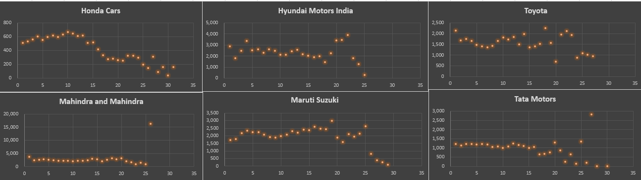
Honda cars the maximum price reached is for pod position 10 but it then starts decreasing as pod position increases. there is increasing also and drastic change also
And used pivot table and also pivot chart for the visualization

Slide 8
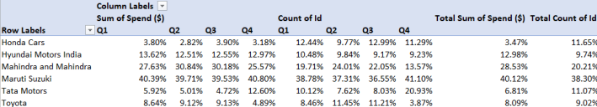
share of various brands in TV airings and how has it changed from Q1 to Q4 in 2021
I made this table using the pivot table
Honda cars as lower percent of spend on ads
Maruti Suzuki spend more compared to other brand
Tata motors are increased as spend in q4 more then 100% percent compared to q1
Toyaota drastically decresed the ad spend from 9 to 5
M and m increased in q2 and q3 but decresd in q4

Slide 9
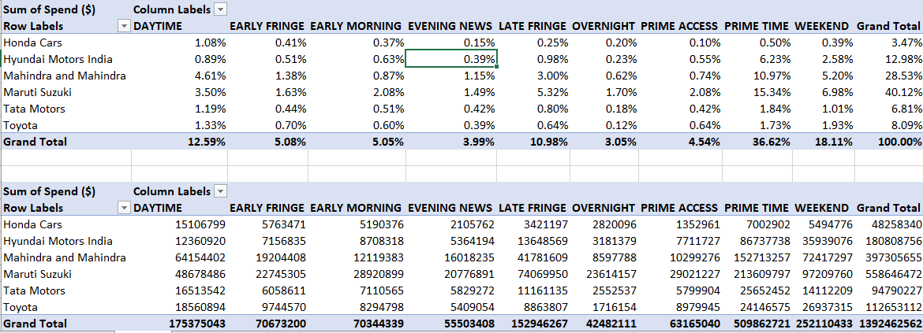
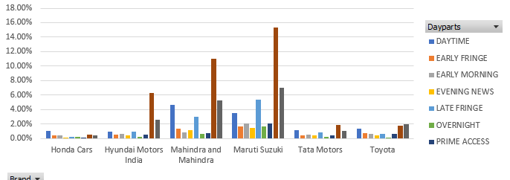
competitive analysis for the brands on the spends
n

Slide 10
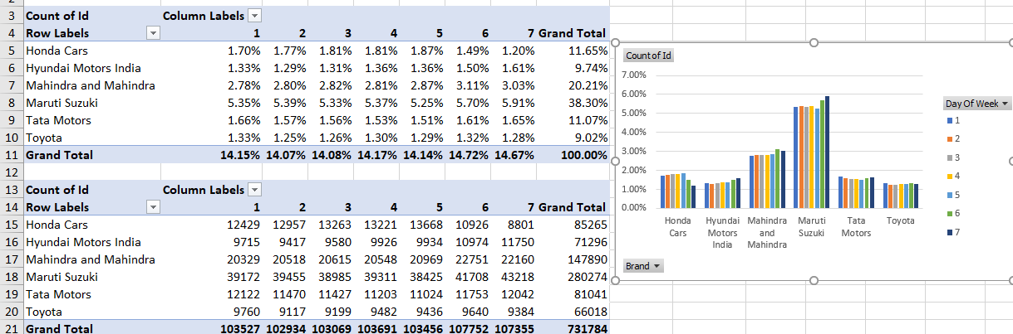
brand broad casting their ads in difference days of week

Slide 11
Summary of competitive analysis
MarutiSuzuki spend more in the primetime for the add and also it is spending more money compared to other brand
Honda cars spending less amount in the prime access
In the over night brands are spending less money because of less watching
We can observe that all day of week brand are adding their advertise and there is no more changes
Marutisuzuki broadcasting more ads in 7th day of week
Prime time and week end days are more then other days the company is spending the money
Honda cars spending less amount
Toyota doesn’t have a specific preference when it comes to selecting a specific time to show its ads

Slide 12
media plan to the CMO of Mahindra and Mahindra
Mahindra and Mahindra spend less amount comparing to the maruthi suzuki
Mahindra and Mahindra should focus on the weekend and primetime because another brand take over that position and also this these 2 daypart very important because of many are watching advertise in this time
We can observe that their increasing in the broadcast and drastically decresing it not good for any company and also q1 of 2022 getting tougher for the ad
And also they want to target daytime and primetime
Row Labels | JAN | FEB | MAR | APR | MAY | JUN | JUL | AUG | SEP | OCT | NOV | DEC | Grand Total
Mahindra and Mahindra | 18.18% | 19.81% | 21.71% | 25.38% | 23.59% | 23.29% | 21.41% | 22.38% | 22.39% | 16.09% | 11.70% | 12.34% | 20.21%

